Slide 1
DSA Project
STATIC IP ROUTING Using Dijktra's Algorithm
Soham Mahajan
112003139

Slide 2
Data structures and Algorithms:
Graph Using Adjacency List to represent Network.
Min Heap Data Structure for Dijkstra's Algorithm.
Trie ADS to store IP addresses in Binary Format.
Linked List to store Devices Information.
Dijkstra's Shortest Path Algorithm.

Slide 3
Representation of Network:
Graph is represented by router nodes(V) connected to each other by edges(E).
Functions :-
Create Graph
Add Edge
Adjacency Matrix used to check existing edges is used.
O(1) Time Complexity to add edge using Adjacency list.
Delete Edge
O(V) Time Complexity to delete edge using Adjacency list.
Print Network
O(V + E) Time complexity is required to print whole graph.

Slide 4
Device representation in Network:
Devices are connected to routers in linked list fashion.
Each Devices has its own IPV4 Address, Subnet Mask and Interface information.
Functions :-
Add devices:
O(1) Time Complexity as insertion is at the beginning of list.
Delete Devices:
O(n) Time Complexity as all IP's are searched for particular IP.
Print Routing Table:
O(n) Time Complexity as all devices are printed.
Where n is total devices connected to each router..

Slide 5
Conversion OF IP into binary form:
IP Address of each device is converted into 32 bits binary format.
IPs are stored in tries to forward packet using longest prefix matching technique easily.
Ex: 2.2.2.2 IP Address gets converted into 00000010000000100000001000000010 in 32 bits binary format.
Functions :-
Is valid IP address: To check whether IP Address is correct or not. Strtok function is used.
Convert IP to binary: It converts IP address into binary format. Strtok function is used for tokenization and Itoa function is used to convert number into string binary form.

Slide 6
IP Storage In Tries:
Insert in Trie: This function is used to insert converted string in tries. Time Complexity is order of inserted string length i.e., O(length).
Search in Trie: This function is used to search particular string in tries. Time Complexity is order of searched string length i.e., O(length).
Delete in Trie: This function is used to delete particular string in tries. Time Complexity is order of deleted string length i.e., O(length).
Destroy Trie: This function frees all nodes in tries. Time Complexity is of order O(2^n) where n is maximum string length which in my case in 32.
Longest Prefix Matching: This function helps to send data packets to longest prefix matching IP.
Exact Match: This function helps to send data packets to exact IP location.
.

Slide 7
Dijkstra's Algorithm:
This Algorithm is used to generate shortest path tree (shortest path from source vertex to all other vertex available in network).
This Algorithm is implemented using Min Heap Data structure.
Algorithm has Time Complexity as O(E*log V) in Adjacency list whereas O(V^2) in case of Adjacency Matrix.
Functions :-
create_heap : To create Min Heap from graph.
min_heapify : To Heapify the Min Heap at root position.
swap_nodes : To swap heap nodes.
update_distance : To update distance values. Time Complexity is O(Log V). V is total vertices.
extract_min : To extract root node from Min Heap.

Slide 8
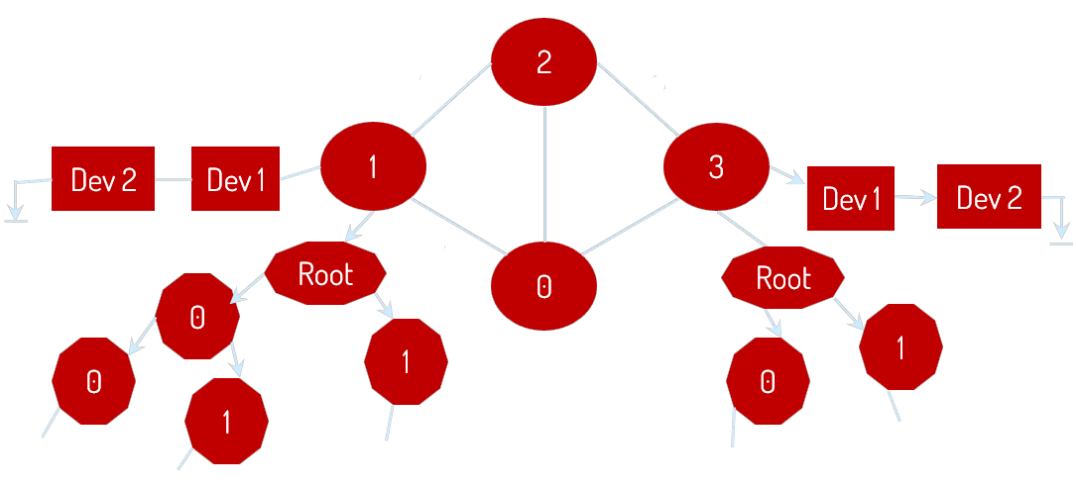
Demo Network:
2
9
5
4
8

Slide 9
Future extra Functions:
Use of proper subnetting technique to convert split IP into Network ID and Host ID.
Use of IPV6 Addresses can be used.
IPV4 are 32-bit addresses whereas IPV6 are 128-bit addresses.

